Slide 1
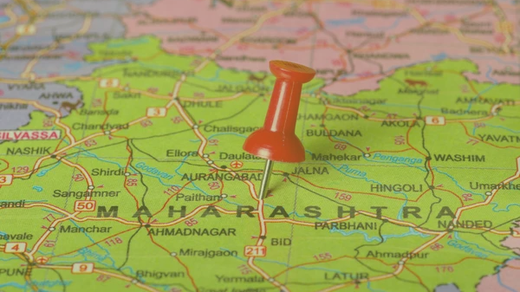
Analysis Of Tourists In Maharashtra
Team Falcons
01

Slide 2
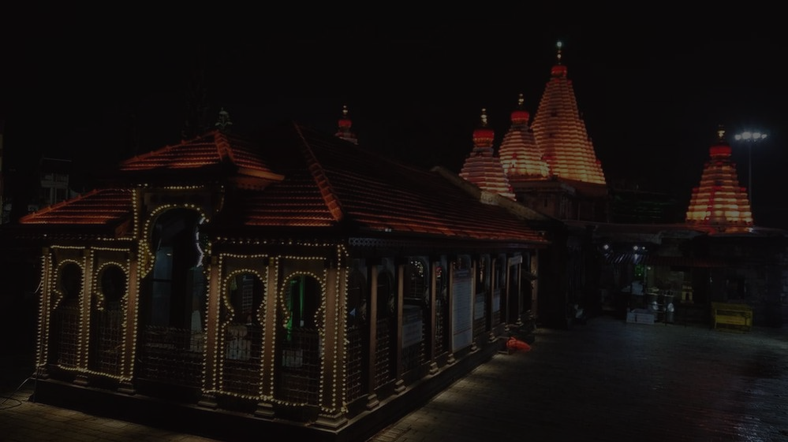
Why this project?
Tourism in India is one of the most important social and economic activities. Tourism alone contributes to 17.2% of India’s GDP.
We see an average of 17.9 million Foreign Tourists Arrival (FTA) each year.
Through our project we aim to understand travel patterns and predict locations to tourists based on their visits to heritage sites, tourist spots including shrines, temples and locally famous spots for Maharashtra.
02

Slide 3
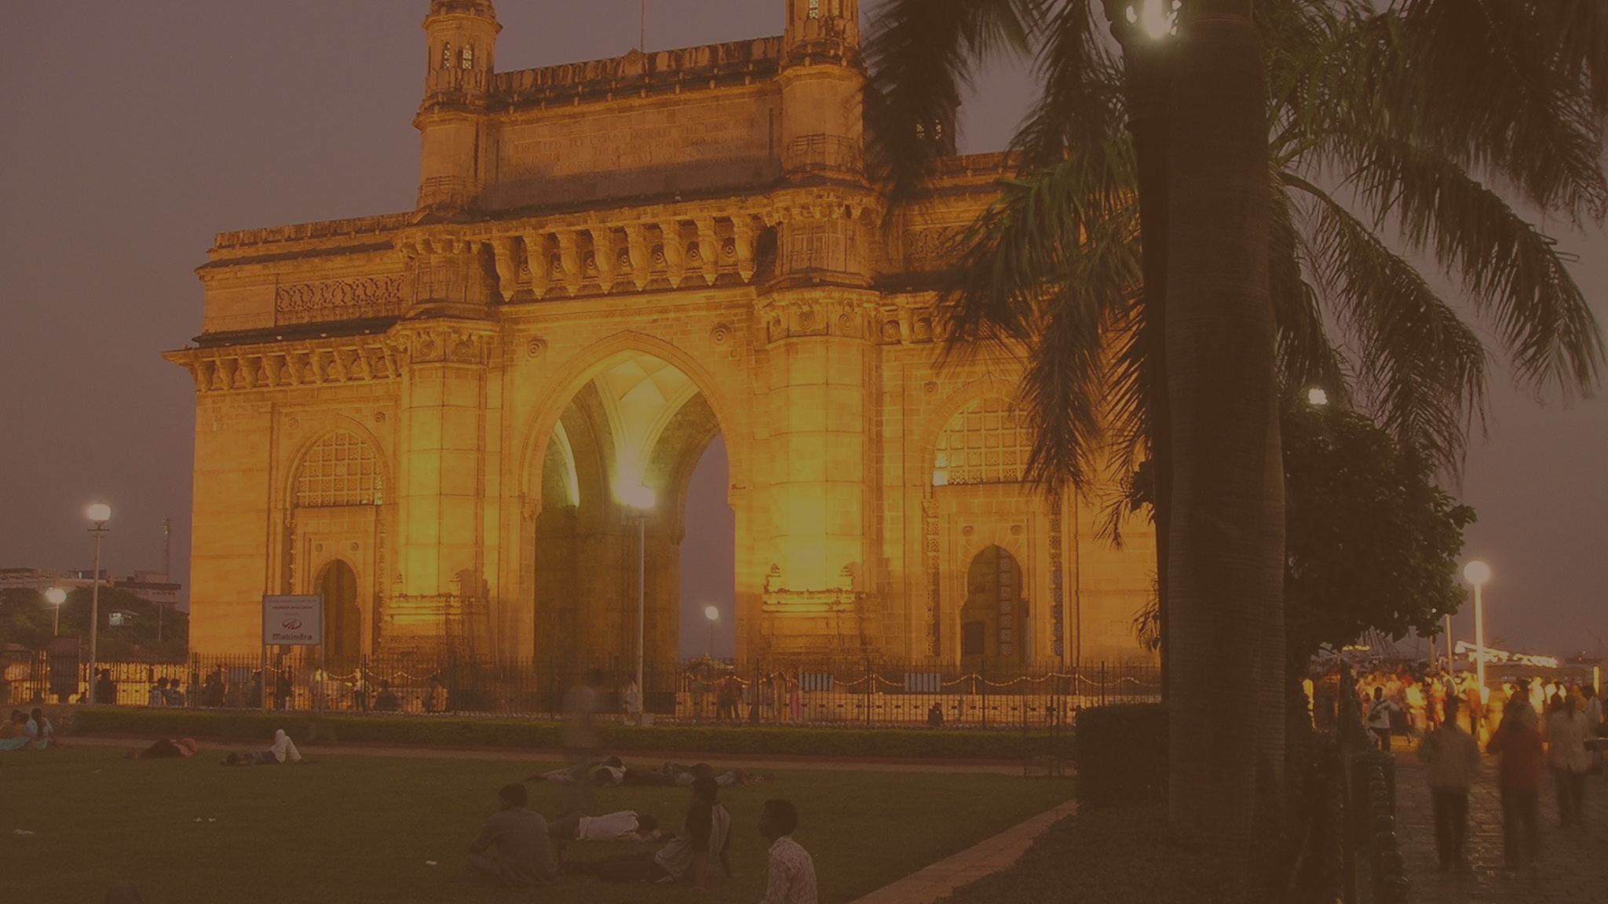
Methodology
Collection of data from various sources.
Joining the different tables based on relevant columns into one single table.
Cleaning and Processing the data. Finding the patterns and trends.
Get some visualisations
Create a recommendation system
03

Slide 4
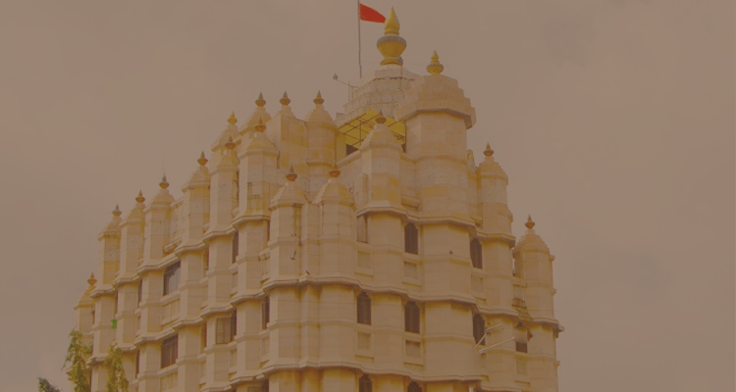
Data & Variables
Our data consists of all the tourists domestic and foreign for the years 2011-2014.
For each year we have about 1500 data points.
We have tourists divided into many categories:
Age (15-24, 25-34, 35-44, 45-60, >60)
Sex
Purpose of visit
Nationality
Month of arrival
Year of arrival
City / District
Place
04

Slide 5
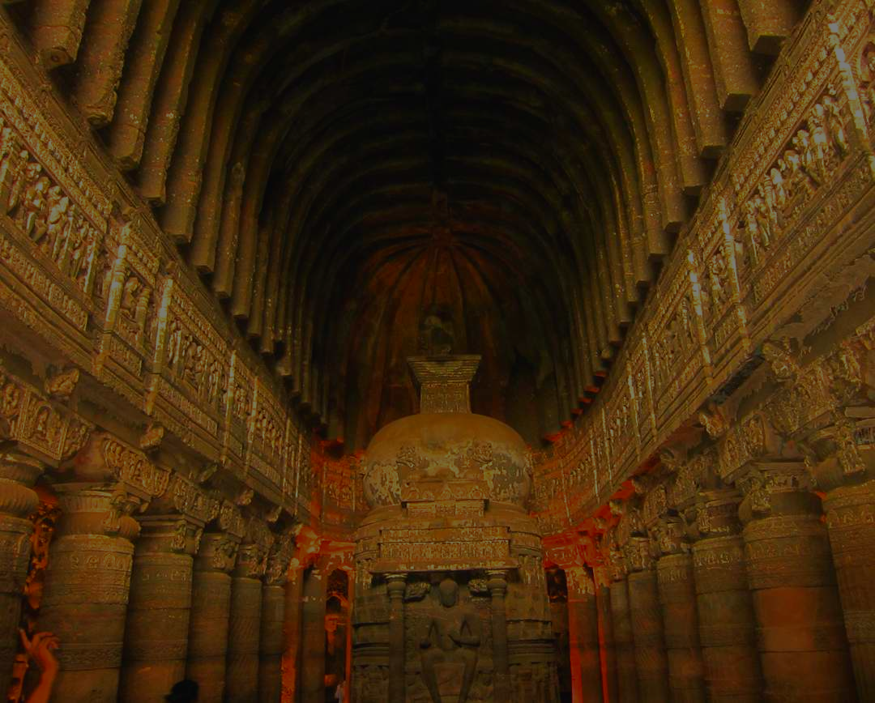
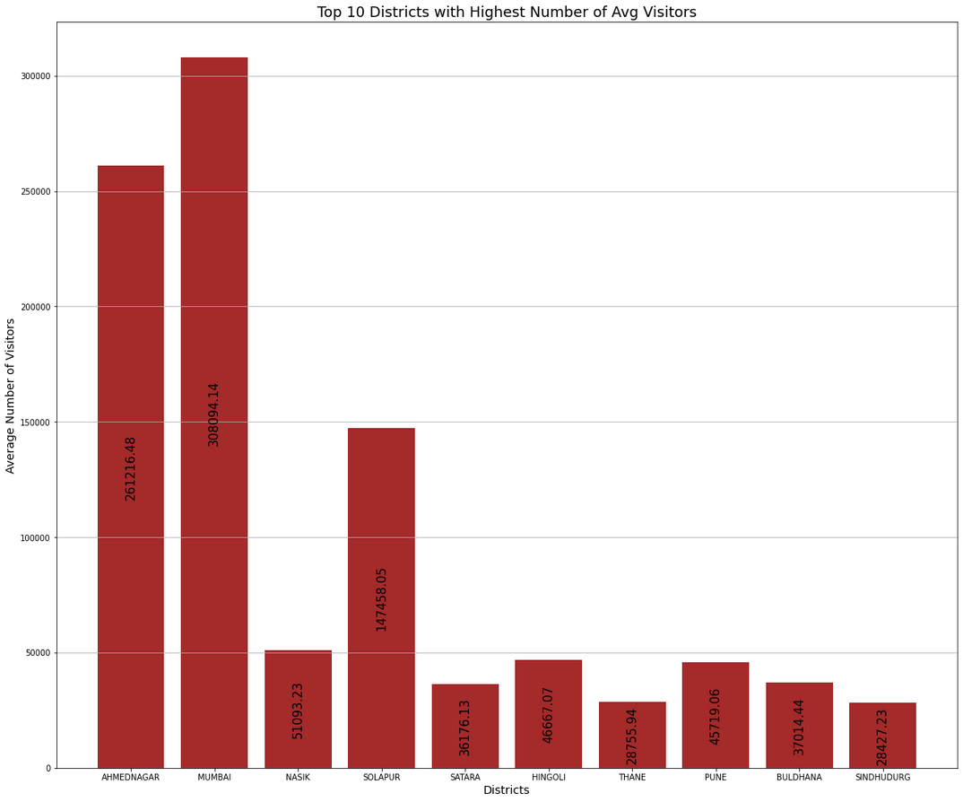
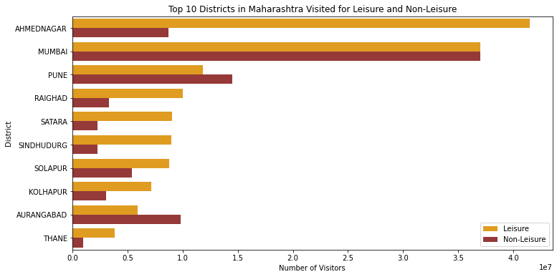
Results
05

Slide 6
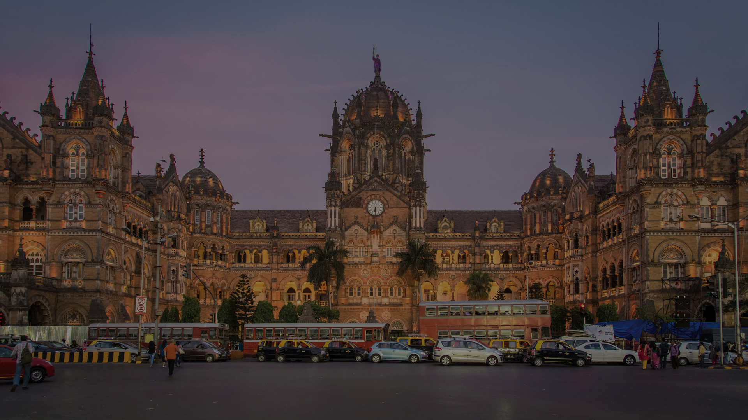
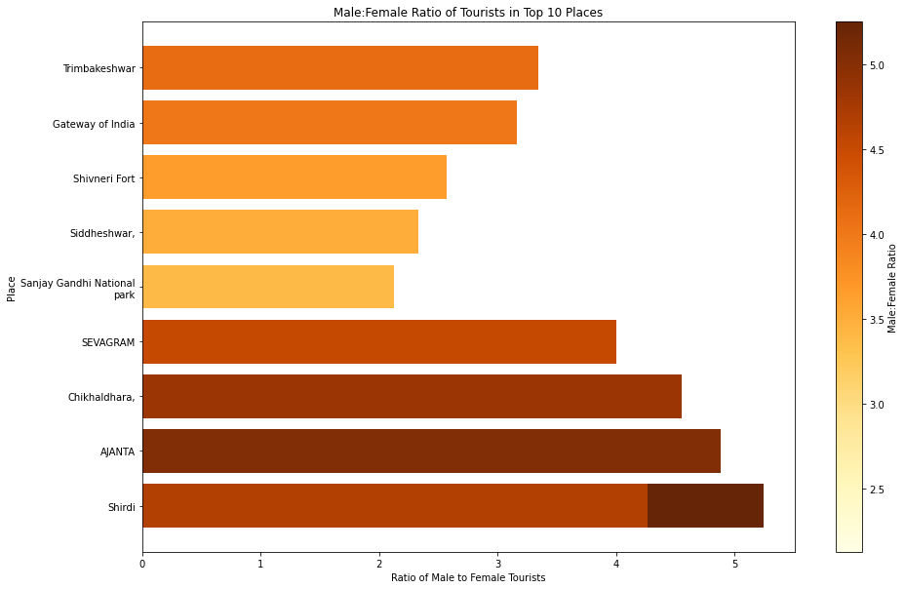
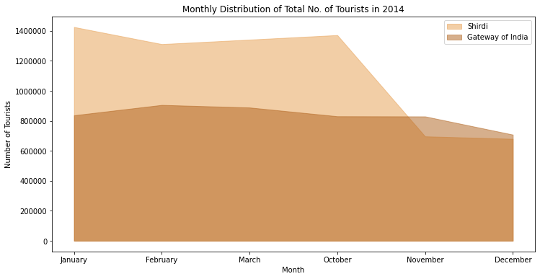
Results
06

Slide 7
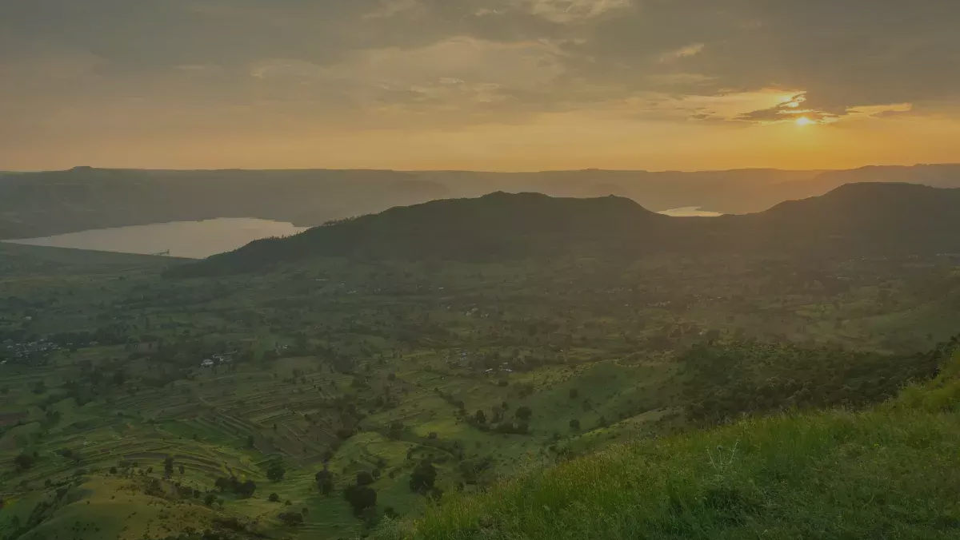
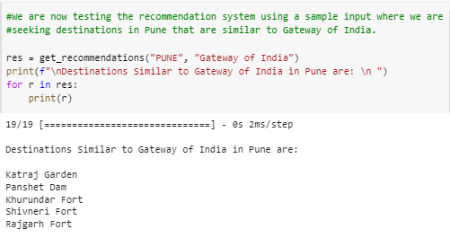
Recommendation System
A neural-network based recommendation system is developed.
This system takes in the district and destination as input and generates recommendations for other destinations within the same state/district that may be of interest to the tourist.
07

Slide 8
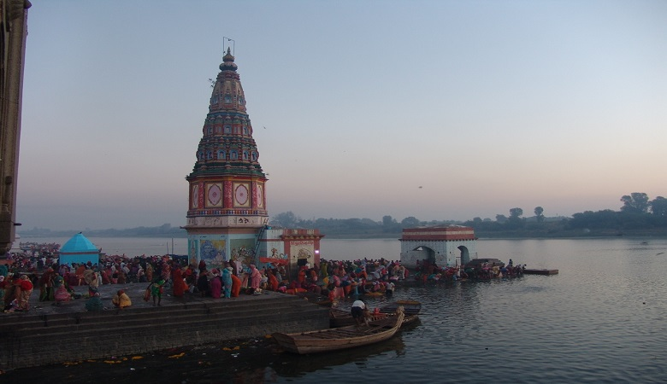
Conclusion
Future Scope
According to our analysis:
Total domestic tourist arrivals in Maharashtra from 2011 to 2014 = 107.08 million.
Total foreign tourist arrivals in Maharashtra from 2011 to 2014: 12.97 million.
Top districts with tourist arrivals are: Mumbai & Ahmednagar.
The domestic tourists prefer temples and holy cities whereas foreign tourists frequent Mumbai, Pune & Nashik.
Females prefer visiting temple cities and historical monuments while male prefer forts, parks and modern monuments
Generating different insights and visualizations is possible by modifying the queries.
Clustering algorithms can be employed to group similar destinations and districts.
The current recommendation system can be enhanced by considering whether the tourist is domestic or foreign.
Adding more states from across India to the dataset can improve its quality.
To provide more up-to-date recommendations, additional years of tourist data beyond 2011, 2012, 2013, and 2014 can be included in the dataset
08

Slide 9
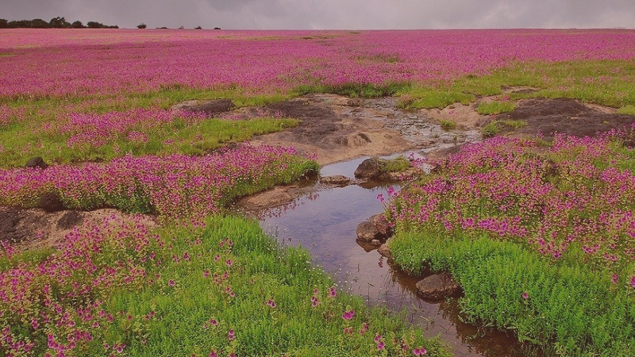
Thank You
09

